Slide 1
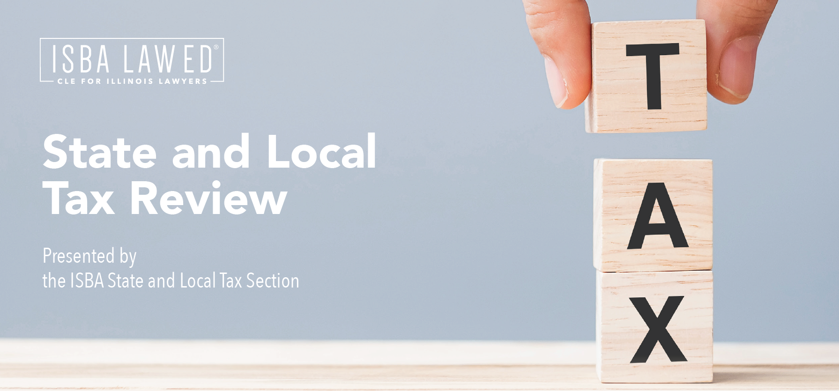

Slide 2
Moderator – Natalie M. Martin, Kupiec & Martin, LLC
Brian E. Fliflet
Deputy General Counsel
Illinois Department of Revenue
Telephone: 312-814-0004 Fax: 312 - 814 -1402 Email: brian.fliflet@illinois.gov Website: www.tax.Illinois.gov
David J. Kupiec
Kupiec & Martin, LLC
600 West Van Buren Street, Suite 202
Chicago, Illinois 60607
312-632-1022
dkupiec@kupiecandmartin.com
David P. Dorner Partner ReedSmith LLP 312.207.2402 – Chicago
773.852.5111 - Mobile ddorner@reedsmith.com
10 South Wacker Drive, 40th Floor
Chicago, IL 60606-7507

Slide 3
Disclaimer
This PowerPoint presentation is provided for general informational purposes only. The information contained in this presentation should not be construed as legal advice from the Illinois Department of Revenue or the presenter for any purpose, including but not limited to the Taxpayers’ Bill of Rights, nor is it intended to be a substitute for legal counsel on any subject matter. IDOR advises that audience members pursue appropriate legal or other professional advice when seeking guidance, based upon their particular facts and circumstances.

Slide 4
Illinois Fiscal Condition
After 17 downgrades over 20 years, Illinois received two credit rating upgrades during last two years from Moody’s, S&P and Fitch
Illinois Family Relief Plan returned $1.8 billion to residents in the form of income tax and property tax rebates and by suspending the grocery tax for one year and suspending the scheduled increase in the gas tax for six months
$1.8 billion transferred to Unemployment Insurance Trust Fund
Repay remaining $1.35 billion loan from federal government
Make $450 million interest-free loan
Repayments through business taxes placed in Budget Stabilization Fund

Slide 5
Illinois tax collections
Total Income tax collections in fiscal year 2022 were up 23% compared to fiscal year 2021 and 58% compared to fiscal year 2020
Business income tax collections were up 84.1% in fiscal year 2022 compared to fiscal year 2021
Individual income tax collections were up 4.1% in fiscal year 2022 compared to fiscal year 2021

Slide 6
Corporate income tax collections
+ 129%

Slide 7
Rulemaking - Some Regarding Income Tax
86 IAC 100.2300—Illinois net loss carry backs and net loss carryovers
Incorporates $100,000 cap on IL NLD for tax years ending on or after December 31, 2021, and before December 31, 2024
Incorporates extension of period for carrying losses from 12 years to 20 years
86 IAC 100.3200—Taxability in another state
For purposes of determining whether certain sales are subject to throwout or throwback, removes stipulation regarding treaties with foreign countries

Slide 8
Rulemaking – Some Regarding Income Tax
86 IAC 100.5020—Extensions of time for filing returns
For extended due date for filing corporate income tax returns, restores additional one month after extended due date for filing federal returns
Applies to tax years ending on or after December 31, 2021
89 IAC 100.2198 – EDGE Credit clawback
When a Taxpayer ceases operations at an EDGE Credit location
Effective July 12, 2022

Slide 9
Rulemaking – Some Regarding Sales Tax
86 IAC Part 131 – Leveling the Playing Field for Illinois Retail Act
Collection of MPA ROT and Chicago Soft Drink Tax
Treatment of certain occasional sales
Clarify recordkeeping requirements for marketplace facilitators
Effective January 27, 2022
89 IAC 130.701 – Certificates of Registration
Allows IDOR to post a Notice of Expiration of Certificate of Registration
Effective June 7, 2022

Slide 10
Rulemaking – Some Regarding Sales Tax
86 IAC 130.425, 130.455, 150.201, 150.1101, 151.105 – Trade-in Allowances
Removes the $10,000 cap on vehicle trade-ins and increases vehicle use tax due on private vehicle sales
Effective October 25, 2022
89 IAC 140.1601 – Bulk Sales
Implements P.A. 100-1171 which, effective January 4, 2019, changed the requirements for Taxpayers making Bulk Sales.

Slide 11
Rulemaking – Some Regarding Sales Tax
86 IAC 130.1520, 140.1420, 150.1420, 160.151 – Verified Credits
Allows verified credits to be converted into credit memoranda at any time
Effective November 1, 2022

Slide 12
Illinois Court Cases
Marathon Petroleum Co. LP v. Cook County Dep’t of Revenue, 2022 IL App (1st) 210635, Dec. 30, 2022
Cook County Retail Sale of Gasoline and Diesel Tax Ordinance applies to book-out transactions, Reasonable Cause supports abatement of penalties
Hurlbert v. Edmonds, 2022 IL App (4th) 220204, Nov. 30, 2022
Freedom of Information Act request– Exemption to disclosure of data if providing data, most recent county tax map, to commercial requester could be reasonably expected to produce a private gain or a public loss
RN Acquisition, LLC v. Paccar Leasing Comp., 2022 IL App (1st) 211314, Nov. 9, 2022
Chicago Personal Property Lease Transaction Tax is not an ad valorem tax or a local sales tax

Slide 13
Illinois Independent Tax Tribunal Decisions
Midwest Medical Equipment Solutions, Inc.
17 TT 120; 21 TT 77 (September 6, 2022)
Products sold to Medicaid managed care organization do not qualify for exemption for sales made to a governmental body
Mitutoyo America Corporation
21 TT 133 (September 7, 2022)
Taxpayer provided sufficient proof that refund claim was timely filed
PepsiCo Inc. & Affiliates
16 TT 82; 17 TT16 (September 12, 2022)
Taxpayer did not establish reasonable cause for abatement of penalties

Slide 14
Illinois Independent Tax Tribunal Decisions
Greenblatt v. Ill. Dep’t of Rev.
19 TT 104 (November 14, 2022)
Notice of Deficiency vacated as Taxpayer did not appear to receive IRS notification of federal change for tax year at issue.
American Aviation Supply, LLC v. Ill. Dep’t of Rev.
21 TT 27, 21 TT 54 (January 3, 2023)
Taxpayer not entitled to claim the expanded temporary storage exemption on the sale of its aviation fuel as all of the fuel loaded into the airplanes’ fuel tanks was taxable not just that portion burned-off flying over Illinois.

Slide 15
Partnership developments
Pass Through Entity tax
Partnerships and S Corporations may make an election to pay an entity-level tax for tax years ending on or after December 31, 2021 and before January 1, 2026
Tax is 4.95% of net income, and quarterly estimated payments are required
PTE tax credit is passed through to the partners and shareholders on Schedule K-1-P
Partners and shareholders also may claim credit for PTE tax paid in other states
See Publication 129 and Form IL-1065 and IL-1120-ST instructions

Slide 16
Partnership developments
Investment partnerships
Defined in 35 ILCS 5/1501(a)(11.5)
90% of assets must consist of qualifying investment securities, deposits or office space and equipment
90% of income must be derived from interest, dividends and gains on the sale or exchange of qualifying investment securities
Taxable income distributable to nonresident partners is nonbusiness income allocated to state of residence or commercial domicile per 35 ILCS 5/305(c-5)
Private equity funds
Do not meet the 90% assets or 90% income tests
Wind Point partnership cases [22-TT-72, 22-TT-73, 22-TT-74, 22-TT-75, 22-TT-76]
SB 2430 (102nd General Assembly)

Slide 17
Partnership developments
Gain on sale of partnership interests
If nonbusiness income, allocated to state of residence under 35 ILCS 5/301 or commercial domicile under 35 ILCS 5/303
MeadWestvaco Corp. v. Illinois Department of Revenue, 553 U.S. 16 (2008)
Relying on Allied-Signal Inc. v. Dep’t of Taxation and Finance, 229 A.D.2d 759 (N.Y. App. 1996), IDOR argued that despite lack of unitary relationship, tax could be imposed due to investee’s in-state contacts
Corrigan v. Testa, 73 N.E.3d 381 (Ohio 2016)
Nonresident investor in PTE, whose connection to state was indirect, could not be subject to tax on capital gain

Slide 18
Partnership developments
Gain on sale of partnership interests cont…
Nowell Industries, Inc. v. Idaho State Tax Commission, 470 P.3d 1176 (Idaho 2020), certiorari denied, 114 S. Ct. 1391 (2021)
Nondomiciliary corporation’s gain on sale of interest in PTE was nonbusiness income
VAS Holdings & Investments LLC v. Commissioner of Revenue, 186 N.E.3d 1240 (Mass. 2022)
Taxing capital gain based on investee’s apportionment percentage “satisfies the constitutional requirement that there be a rational relationship between the tax and the activities of the entity that is the source of the value.”

Slide 19
Common Income Tax Audit Issues
Residency of Individuals
Personal Services Income
Sales Factor Apportionment – Throwback
Sales Factor Apportionment - Intangibles
Unitary Group – Members, Other Issues
80/20 Company Issues
Bonus Depreciation Addbacks
Credits – R&D, ….
Net Loss Deductions - Carrybacks
Supporting Books and Records

Slide 20
Common Sales Tax Audit Issues
Sourcing of Sales
Marketplace Sales Issues
Resale or Exemption Certificates
High Tax Rate vs. Low Tax Rate Issues
Exempt Transactions
Separation of Services and Delivery Charges

Slide 21
Illinois Franchise Tax
New Secretary of State
Allocation Factor Issues
Audits

Slide 22
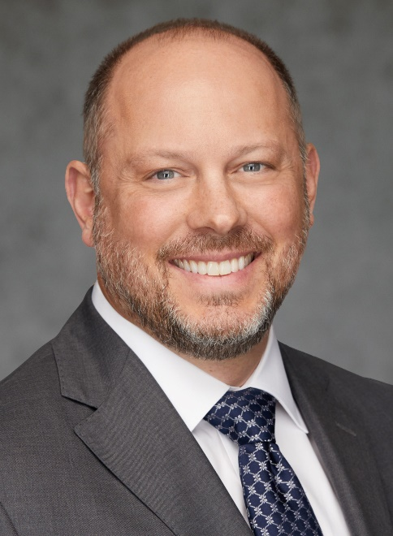
Thank you… please reach out with questions!
Brian E. Fliflet
Deputy General Counsel
Illinois Department of Revenue
Telephone: 312-814-0004 Fax: 312 - 814 -1402 Email: brian.fliflet@illinois.gov
Website: www.tax.Illinois.gov
David J. Kupiec
Kupiec & Martin, LLC
600 West Van Buren Street Suite 202
Chicago, Illinois 60607
312-632-1022
dkupiec@kupiecandmartin.com
Natalie M. Martin
Kupiec & Martin, LLC
600 West Van Buren Street Suite 202
Chicago, Illinois 60607
312-632-1023
nmartin@kupiecandmartin.com
David P. Dorner ReedSmith LLP 312.207.2402 – Chicago
773.852.5111 - Mobile ddorner@reedsmith.com
10 South Wacker Drive, 40th Floor
Chicago, IL 60606-7507

